Slide 1
CSE424: Pattern Recognition
A Pattern Recognition Approach for Bangla Question Answering System Group: 06
Presented by
Member 1: Rubayet Mahjabin
ID - 20101011
Member 2: Humayra Musarrat
ID - 20101089 Member 3: Mubtasim Fuad Mozumder
ID - 20101463
Member 4: Jamilatun Subarna
ID - 21101069
Ssr
ssss
ST:Mehnaz
RA:Ehsanur Rahman Rhythm

Slide 2
Background and Motivation
Natural Language Processing (NLP) in Bangla
Challenges unique to Bangla Q&A
Growing demand for solutions in digital Bangla communication

Slide 3
Statement of the Problem
Difficulties in pattern recognition for Bangla Q&A
Challenges: spelling errors, polysemy, nested entities
Potential with transformer-based models like BERT and GPT-3

Slide 4
Objectives of the Research
Assessing Transformer models for Bangla Q&A
Metrics: pattern accuracy, F1 scores, answerability prediction
Addressing linguistic challenges through novel techniques

Slide 5
Literature Review
Evolution from rule-based to data-driven approaches
Transformer's impact on NLP
Introduction of BERT, GPT-3, and T5 models
Transformer's role in language modeling for NLP tasks
Transformer's rejection of recurrence for parallelization
BERT's bidirectional representations for better context
GPT-3's few-shot generalization capabilities
Encoder-decoder architectures like T5

Slide 6
Data Collection
Utilization of the Bangla-Dataset-for-Question-Answer-System
Data structure and content details
Importance of diverse sources for a comprehensive dataset

Slide 7
Preprocessing and Exploratory Data Analysis
Importing data into a Pandas DataFrame
Tokenization using NLTK
Histograms for token lengths and content relevance
Insights from frequency distributions of top words

Slide 8
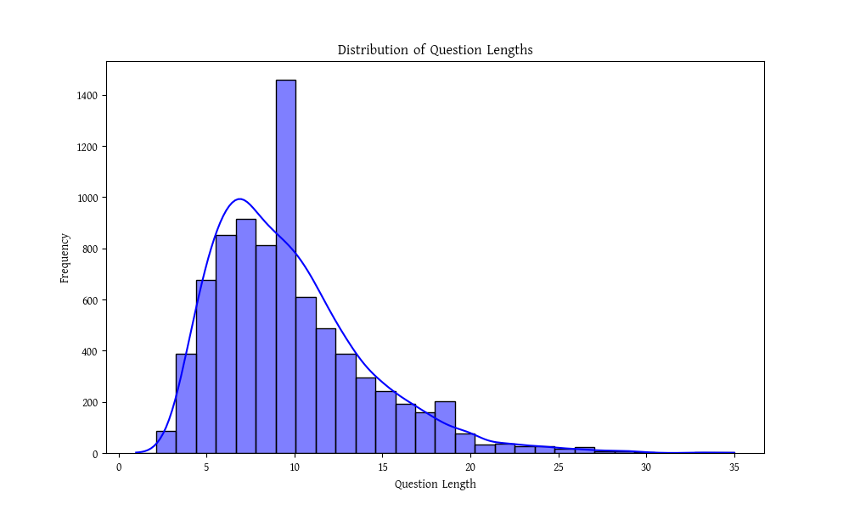
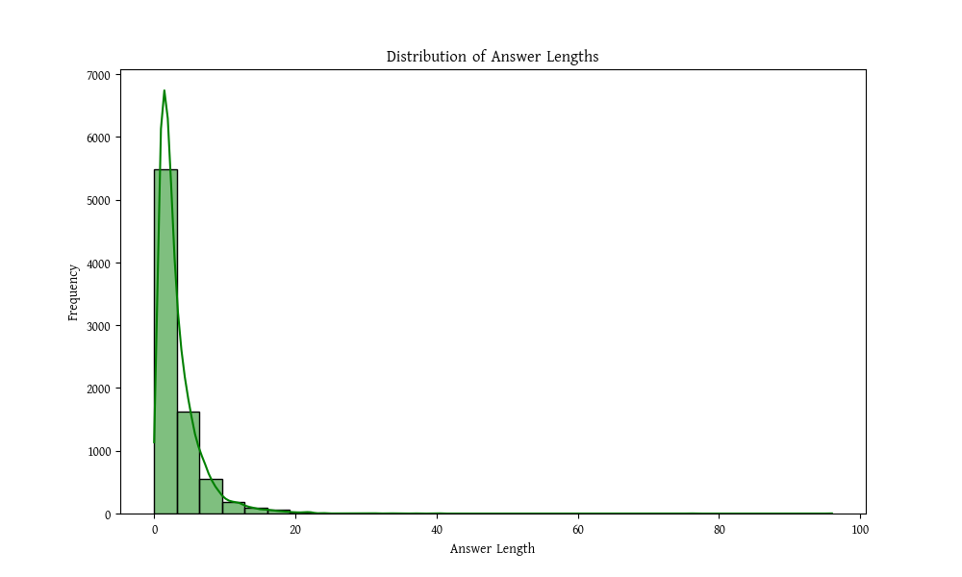
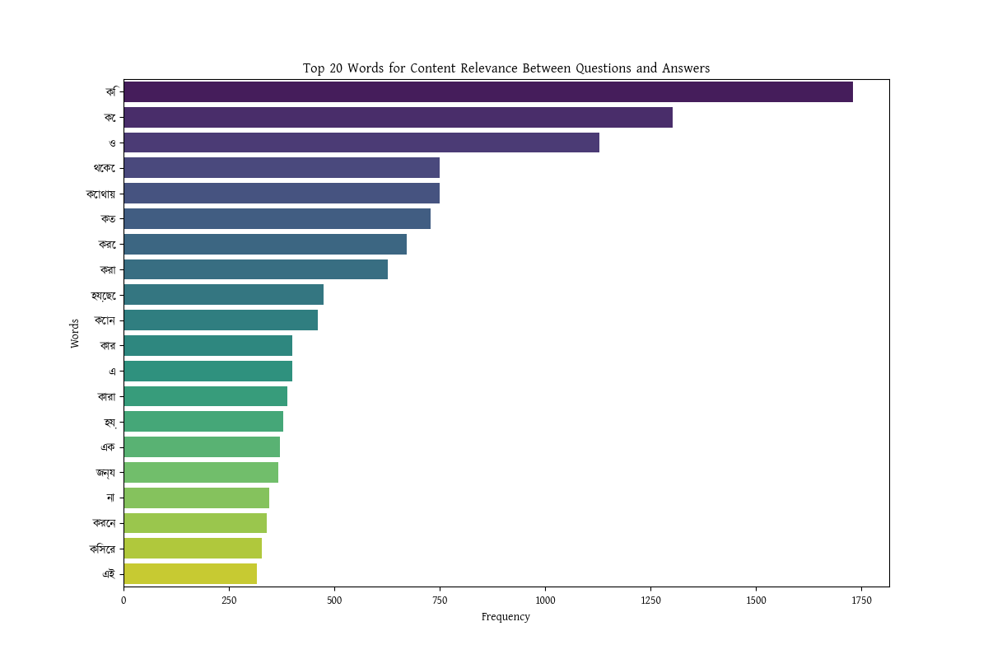

Slide 9
Model Description

Slide 10
Bangla BERT: Bidirectional Encoder Representations from Transformers

Slide 11
Long Short-Term Memory (LSTM)

Slide 12
BERT + LSTM - Ensemble

Slide 13
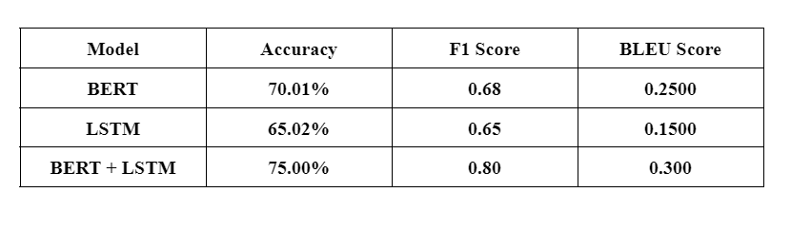
Results

Slide 14
Challenges and Future Directions

Slide 15
Challenges Encountered
Data Limitations:
Insufficient labeled Bangla QA datasets.
Hindrance in training and evaluation due to the scarcity of comprehensive datasets in Bangla.
Diverse Question Types and Linguistic Nuances:
Rich tapestry of linguistic nuances and varied question types in Bangla.
Adaptation challenges for models to recognize and respond accurately to this linguistic diversity.
Generalization Issue:
Gap in model performance across varied domains.
Models need to comprehend general knowledge questions and exhibit domain-specific expertise.
Real-world Unpredictability:
Handling questions with deviations from standard linguistic structures.
Models need to be robust in dynamic, real-world scenarios.

Slide 16
Recommendations for Future Research
Overcoming Data Scarcity:
Collaborative creation of larger and more diverse Bangla QA datasets.
Partnerships between research institutions, industry experts, and linguistic communities.
Active Learning Techniques:
Implementation of active learning to iteratively improve model understanding.
Allowing models to interactively query for new, informative data points.
Custom Transformer Architectures:
Exploration of novel transformer architectures tailored for Bangla language intricacies.
Designing architectures to capture Bangla grammar, syntax, and semantics effectively.

Slide 17
CONCLUSION

Slide 18
Thank You

